Slide 1

Exploratory Data Analysis of AMCAT Data
Submitted By
Rangam Sai Charan
Intern ID: IN9240759

Slide 2
About me
Hi everyone, I'm Rangam Sai Charan, a recent graduate from IIIT Dharwad.
Degree: B.Tech in Information Technology from IIIT Dharwad.
I am passionate about leveraging data to extract meaningful insights and solve real-world problems. Data Science combines my interests in technology and analytics, allowing me to make data-driven decisions that can impact businesses and society positively.
LinkedIn: https://www.linkedin.com/in/rangam-sai-charan-4a67b821a/

Slide 3
Business Problem
Introduction
The Aspiring Minds Employment Outcome 2015 (AMEO) dataset is focused on analyzing the employment outcomes of engineering graduates. This dataset provides insights into various factors that influence the employability of graduates, particularly in terms of salary, job titles, and job locations. The data contains approximately 4,000 records and 40 variables, including cognitive, technical, and personality skills, as well as demographic information.
Overview
The Overview of this project is to conduct an exploratory data analysis (EDA) on the Aspiring Mind Employment Outcome dataset, focusing on engineering graduates. This analysis aims to uncover insights related to employment outcomes, including salary, job titles, and locations.

Slide 4
Objective Of the Project
Explore Employment Outcomes: Analyze the employment outcomes of engineering graduates using the Aspiring Mind Employment Outcome 2015 (AMEO) dataset.
Examine Influencing Factors: Investigate various factors affecting salary, job titles, and job locations of graduates.
Conduct Univariate and Bivariate Analyses: Identify trends and relationships between key variables such as academic performance, skills assessments, and demographic characteristics.
Outlier Detection and Treatment: Identify outliers in each numerical column that could potentially affect the analysis.
Provide Practical Recommendations: Convert analysis findings into actionable insights and suggestions. Propose strategies for skill development, training programs, certifications, and career advancement specifically designed for engineering graduates.
Investigate Gender and Specialization: Explore any potential relationships between gender and specialization preferences.

Slide 5
Summary of the Data
Total Data Points: The dataset consists of 3,998 entries.
Variables: 39 columns, including ID, Salary, Date of Joining (DOJ), Date of Leaving (DOL), Designation, Job City, Gender, Date of Birth (DOB), academic performance (10th and 12th percentages), college details (college ID, tier, state), degree information, specialization, GPA, graduation year, and various skill scores (English, Logical, Quantitative, Domain, Computer Programming, etc.).
Key Data Insights
Salary Distribution: Salaries vary significantly based on job designations, locations, and fields of specialization.
Impact of Demographics: Gender and educational background are influential factors affecting salary outcomes.
Skill Score Analysis: A correlation exists between various skill assessment scores (English, Logical, Quantitative, etc.) and the resulting salary figures.
Personality Traits: Personal attributes (such as conscientiousness and agreeableness) impact job roles and salary levels.
Data Cleaning and Preprocessing
Missing Values Management: Applied imputation methods to handle missing entries in specific columns.
Duplicate Removal: Ensured the dataset's accuracy by eliminating duplicate records.
Data Standardization: Standardized formats and encoded categorical data for effective analysis.
Outlier Identification: Detected and managed outliers in pertinent columns to maintain the integrity of the analysis.

Slide 6
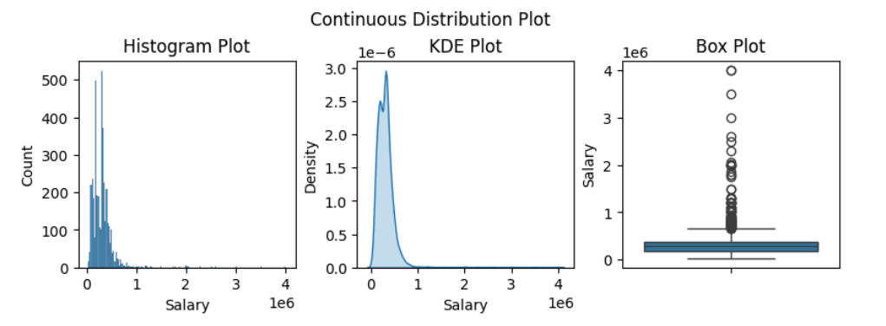
Univariate Analysis
Histogram Plot: The histogram shows a right-skewed distribution of salaries, with a majority of the data points concentrated near zero and fewer instances as the salary increases.
KDE Plot: The KDE plot reinforces the histogram’s findings, displaying a smooth curve that mirrors the distribution of salaries.
Box Plot:: The box plot provides a summary of the salary distribution by showing the median, quartiles, and potential outliers.

Slide 7
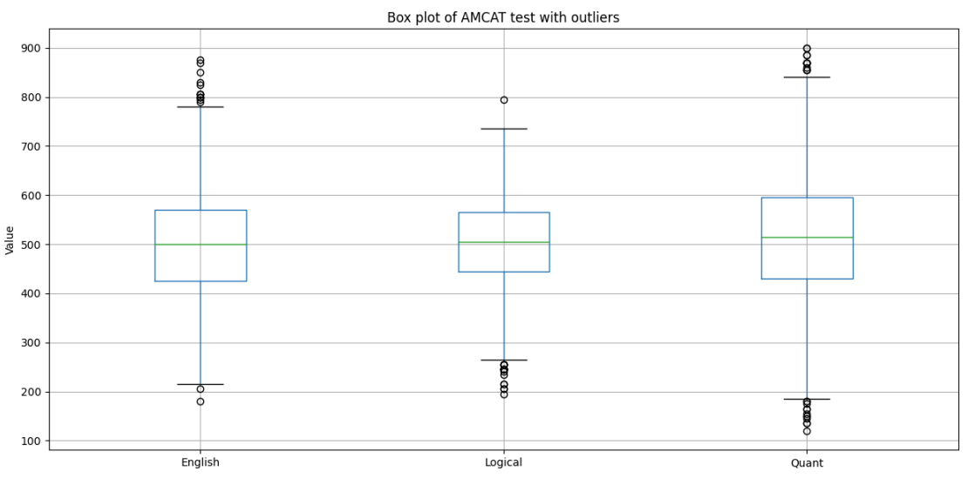
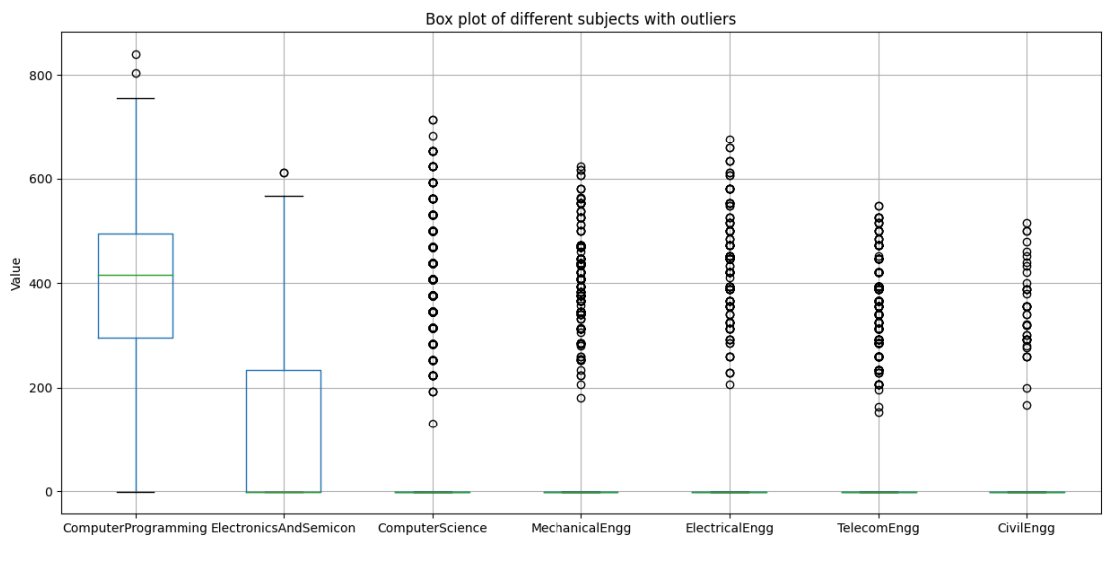
Computer programming shows the greatest variability in scores, with a notably high median value. Meanwhile, fields such as computer science, mechanical, electrical, telecom, and civil engineering display more consistent scores, although with some prominent exceptions.

Slide 8
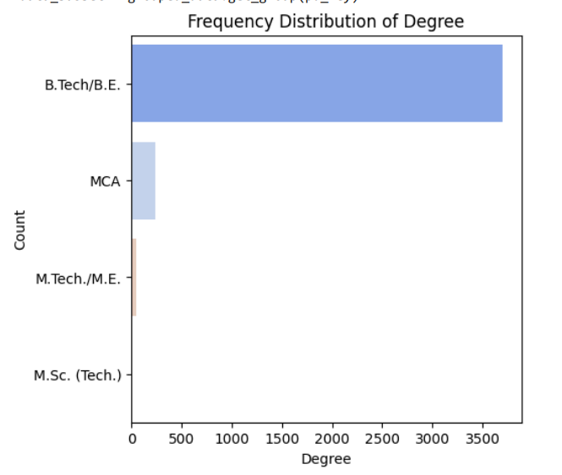
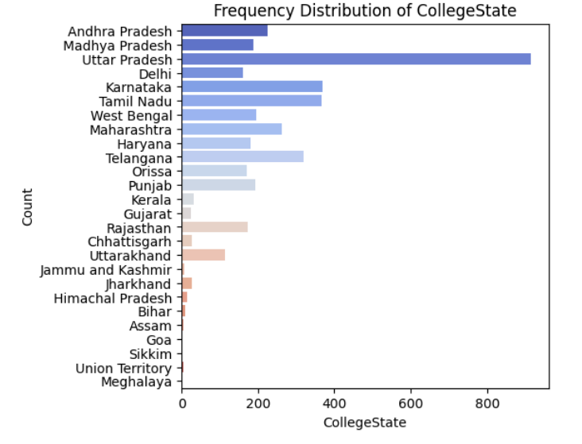
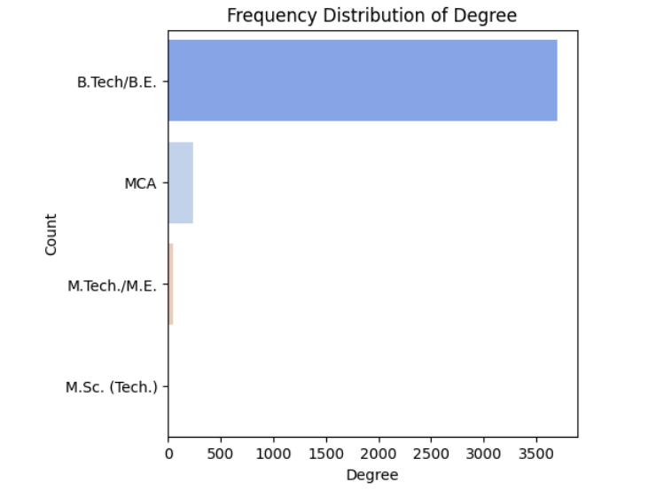
1. More men took the test than women
2. Majority of candidates hold a B.Tech or B.E degree (most common qualification)
3. Tamil Nadu and Karnataka are the next two states with the highest percentage of college-attending candidates (second and third respectively)

Slide 9
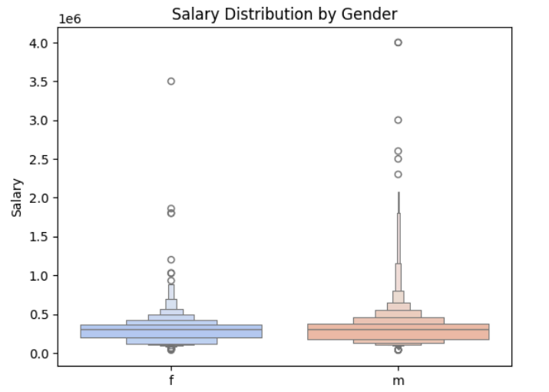
Bivariate Analysis
From the plot, men receive a larger salary distribution, meaning they make more money. However, as we observed in previous analyses, there are not as many men as women in our study. This suggests that the 2015 study had a higher proportion of men than women.

Slide 10
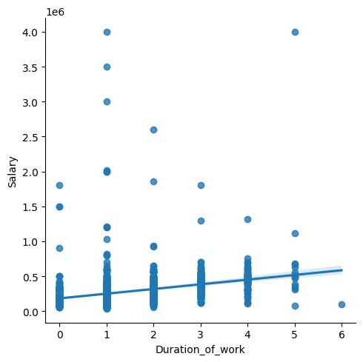
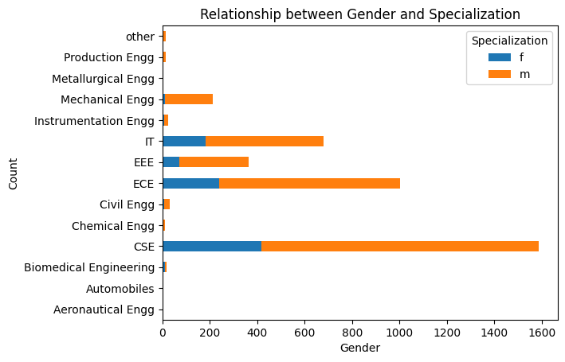
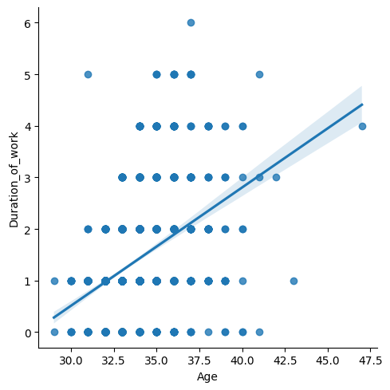
Salary vs Experience
Age vs Experience

Slide 11
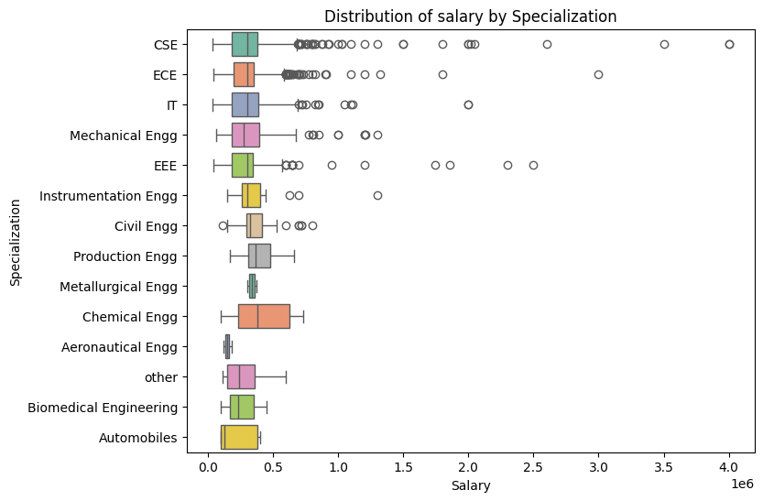
Distribution Of Salary by Specialization
salaries vary significantly across specializations, with some fields having more extreme outliers. Individual factors and market conditions play a crucial role in determining earning potential.

Slide 12
Challenges Faced During Data Analysis
Missing Data: Developing strategies to handle incomplete values and prevent analysis distortion
Outlier Detection: Identifying and managing extreme values to ensure accurate conclusions
Categorical Variable Analysis: Effectively encoding and analyzing categorical variables, particularly those with high cardinality
Feature Selection: Balancing model complexity by selecting relevant variables
Data Preprocessing: Transforming raw data into a usable format through cleaning and expert manipulation
Visualization and Insight Extraction: Accurately interpreting results through effective visualization and uncovering relationships between variables"
Key Findings
Correlation Between Skills and Salary: There is a significant correlation between standardized skill scores (cognitive, technical, and personality) and salary outcomes, indicating that higher skill proficiency can lead to better compensation.
Importance of Continuous Learning: The findings suggest that graduates should pursue additional certifications and skill enhancement programs to remain competitive in the job market.

Slide 13
Conclusion
Successfully carried out data analysis on the AMEO dataset to explore the factors influencing salary outcomes for engineering graduates. The analysis provided key insights and practical recommendations, equipping graduates with valuable information for career advancement and salary discussions.
Skill Development: Graduates with higher scores in cognitive and technical skills such as quantitative ability, logical reasoning, and domain knowledge tend to achieve better job placements. This emphasizes the need for targeted skill development, especially in technical and problem-solving areas.
Geographic and Demographic Influence: The variation in employment outcomes based on job location and demographics suggests that certain regions and groups might benefit from focused interventions, such as infrastructure development or targeted recruitment drives, to level the playing field.
Personality Traits and Job Fit: The impact of personality traits on employment outcomes shows that traits like conscientiousness and openness are significant in determining job success. Programs focusing on soft skills and personality development could enhance employability prospects.
Specialization and Career Growth: The data indicates that certain engineering specializations lead to higher salaries and better job titles. Graduates should be mindful of industry trends and align their specialization with market demand to maximize their career opportunities.
Future efforts will focus on enhancing the models and disseminating findings for wider reach and impact.

Slide 14

THANK YOU

